Slide 1
External perimeter testing
Offensive security tactics for Linux professionals

Slide 2
Agenda
What is External Perimeter Testing?
Firewall Enumeration
Port Scanning
Offensive Python With Requests

Slide 3
What is external perimeter testing?
Deeper assessment of externally available services to attempt achieving command execution/information disclosure
Attempting to locate misconfigurations in firewalls to locate open ports
Achieve initial compromise from externally facing machine based on found misconfigurations
Notes:
External perimeter testing goes further from a vulnerability assessment. We do not just perform the reconnaissance on a target instead we actively try to access the target systems through whatever vulnerability we can find.
Part of these vulnerabilities can involve misconfigured firewalls which leak traffic from internal ports followed by misconfigurations on installed services such as web apps or outdated network services which may be vulnerable to RCE,

Slide 4
Firewall Enumeration
Common installation of firewall on Linux Servers is IPTables
IPTables rules when misconfigured with rules such as REJECT can allow opportunities to enumerate open ports
Enumerating outbound firewall rules can aid in payload weaponization to achieve infiltration or client side attack from external perimeter.

Slide 5
NMAP
One of the best port scanning tools capable to perform various port scanning techniques
Armed with a scripting engine allowing for customisation of traffic
Can be very loud sending a high volume of packets resulting in detection

Slide 6
Port scanning
Active reconnaissance technique used to check the availability of a network port.
Port scanning can be conducted in many ways rather than a typical TCP connect.
Port scanning if done too loud/aggressively can cause defences to trigger

Slide 7
Scanning methods
Using “exotic” TCP flags
Usual ports (Targeting most frequent ports) reducing payload size of scanning
Aggressive scans with known tools (Easy way of getting blocked)
Stealthier scans with custom tools (Preferable to remain hidden)

Slide 8
Netcat
More barebones compared to NMAP but can be used for reverse shell operations
Can scan ports sending one packet to confirm availability but no scripting engine capabilities
Less traffic generation resulting in stealthier approach

Slide 9
SCapy
Packet crafting framework/Python libary. No ready made solution available
Scapy has extensive capabilities in order to create stealthy solutions
Knowledge of Python is required

Slide 10
Offensive Python with requests

Slide 11
Offensive Python with requests
During a penetration test, an HTTPS endpoint was found to be responding in a certain way based on known/unknown usernames of target infrastructure.
Such a situation can warrant exploit development which is what was done for this particular case.
This resulted in username harvesting from the HTTPS endpoint.

Slide 12
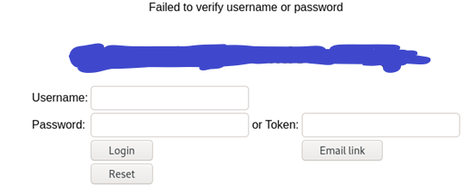
Offensive Python with requests
Response with a known username

Slide 13
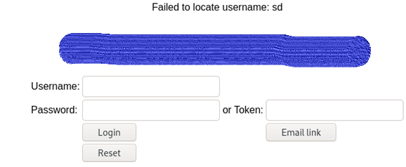
Offensive Python with requests
Response with an unknown username

Slide 14
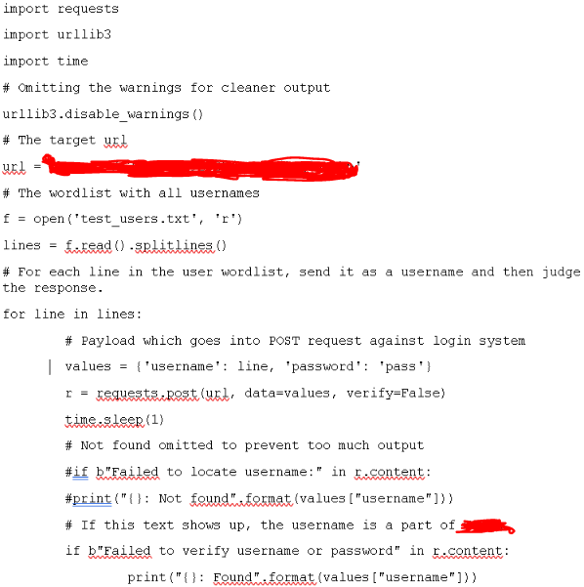
Offensive Python with requests: exploit Code

Slide 15
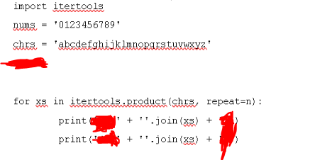
Offensive Python with requests: wordlist Code

Slide 16
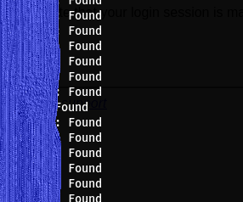
Offensive Python with requests: result

Slide 17
Offensive lessons learnt
Manual enumeration matters after scanning with tools
Developing exploits can save you time and automate situations which may otherwise take a very long time to execute.
You may not get SQL injection from an endpoint but try to look out for other giveaway signs of information disclosure based on output responses.

Slide 18

Questions

Slide 19
Next talk: Client Side Attacks

Slide 20
Thank you
Instructor: Aqeeb Hussain
GitHub: https://github.com/aqeebhussain122/hpc-offensive-security

